Slide 4
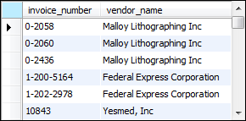
Notes:
Retrieve from 2 tables (vendors and invoices)
INNER JOIN = from the same database
Now, going forward, must be specific (two tables may have same column names)
Name of table DOT column name
There must be a good reason (usually it’s an overlap or a subset)
The selected are the displayed columns
The columns are paired by the column name (the first entry has an invoice number + vendor name with same id)

Slide 6
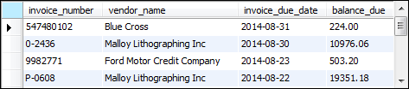
Notes:
The v and i are known as aliases
This point onward, can just use them instead of vendors and invoices

Slide 7
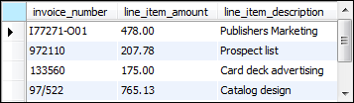

Slide 8
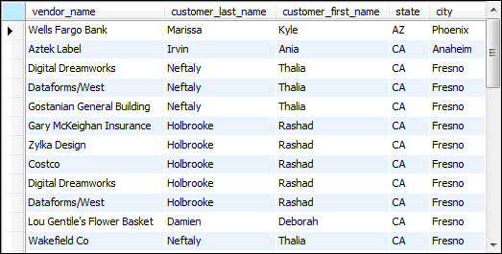
Notes:
What happened if we wanted to use a table from another database?
Use the “dot operator” (not actually called that)
Of course, the database must be on the same server (otherwise, tedious logins and perms)

Slide 9
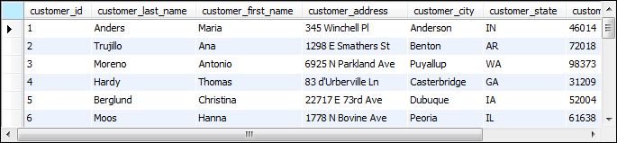
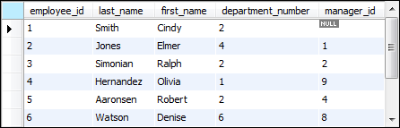

Slide 10

Notes:
Has two conditions
ON specifies the start of conditions
AND mean sthere’s two here

Slide 11
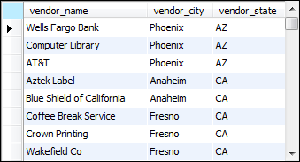
Notes:
<> = not equal

Slide 12
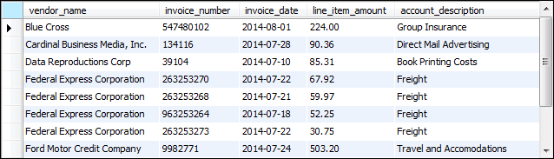
Notes:
Each ON is 1 condition
Each JOIN is another table + 1 with FROM
ORDER BY vendor_name first, then line_item_amount

Slide 13
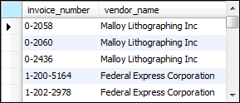

Slide 14
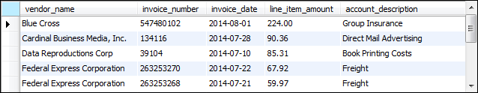

Slide 17
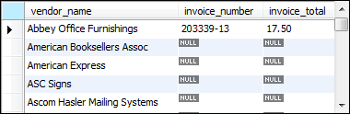
Notes:
Vendors = table 1
Invoices = table 2
Vendors = bigger circle (vendors + the overlap)

Slide 18
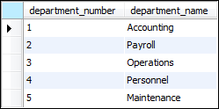
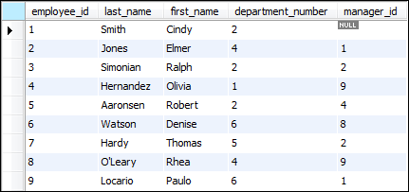

Slide 19
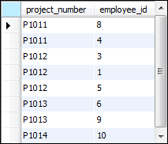

Slide 20
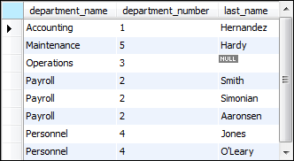
Notes:
More from d rather than e

Slide 21
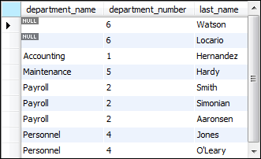

Slide 22
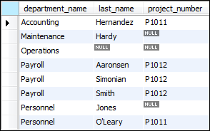
Notes:
Can do multiple 3
As you go on, the tables are being seen less and less

Slide 23
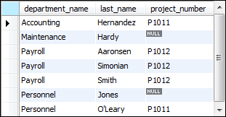

Slide 24
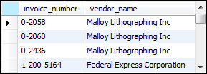

Slide 25
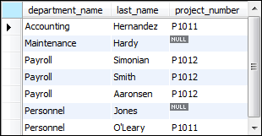

Slide 26


Slide 27
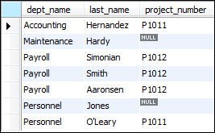

Slide 28
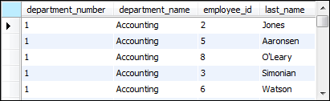

Slide 29
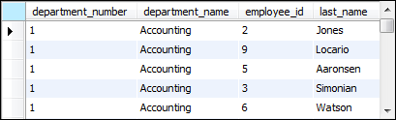

Slide 32
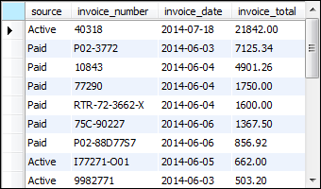
Notes:
Union = EVERYTHING together
Pay attention to before UNION and after
Could’ve run independently? But if you want to merge the result from both, put a UNION in between
You can do as many unions as you want
Usually you split up the database into several tables (yearly basis ex.)
Using union to write against the tables and pull them all together

Slide 33
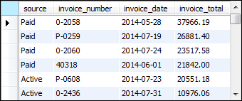

Slide 35
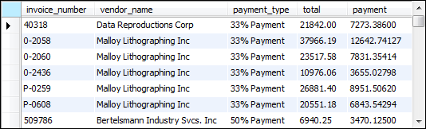

Slide 37
